Slide 1
﻿Capstone project – final presentation
Indrajit Gupta

Slide 2
﻿Introduction and Business Problem
The Chicago police department has asked me to identify the different
crimes that is prevalent in a particular neighbourhood and rank them
with number of occurences
The Police department want to identify the most common crimes in a particular borough so that they can take preventive measures
For example if a borough has theft as the most common type of crime, then the police can alert the residents and suggest them to deploy anti-theft mechanisms in their house
Similarly if in a particular borough, human trafficking is a major problem, then the police can investigate and can catch the racket

Slide 3
Data
﻿To help the police department we will be needing the past crime records
The attributes needed will be Borough name, Crime type, occurrence of the crime type, latitude and longitude
We will then leverage the data in order to determine which type of crime is more prevalent in which borough and will put the boroughs in certain clusters accordingly

Slide 4
﻿Methodology
The data have been collected pertaining to the previous 5 year crime records of Chicago
The count of crime types on the basis of borough has been done and then the count will help to determine the rank of the common crimes
The boroughs have been plotted using folium map and then clustering is done for the top 10 most common crimes using K-Means clustering

Slide 5
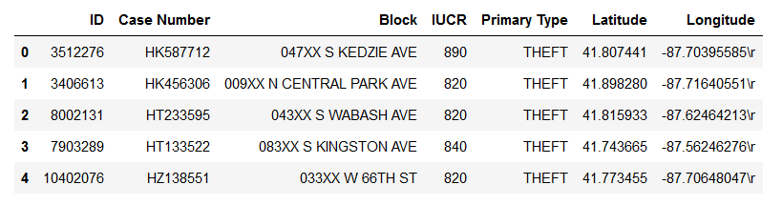
﻿Data received from the official Chicago Database

Slide 6
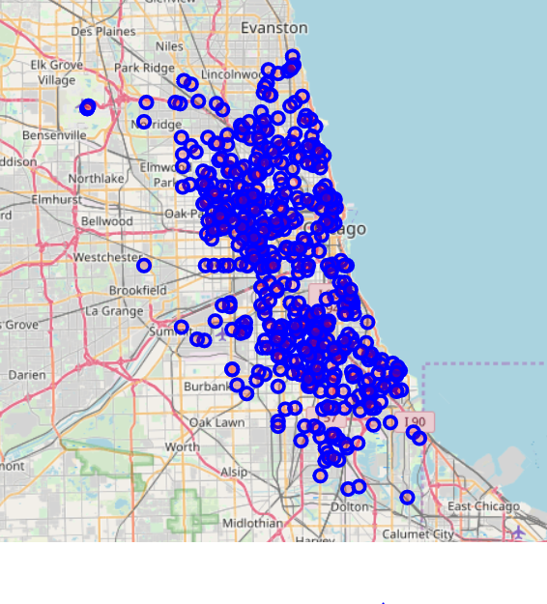
﻿Plotting the boroughs of Chicago

Slide 7
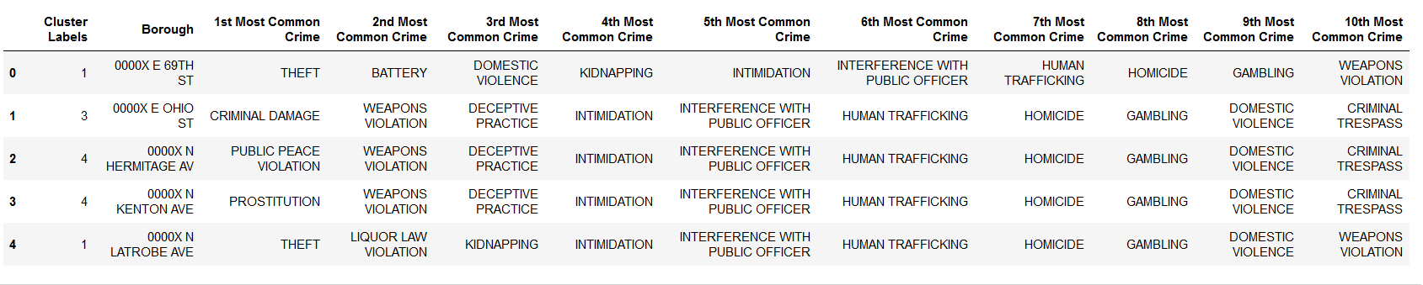
﻿Clustering and classifying the boroughs on the basis of common crime types

Slide 8
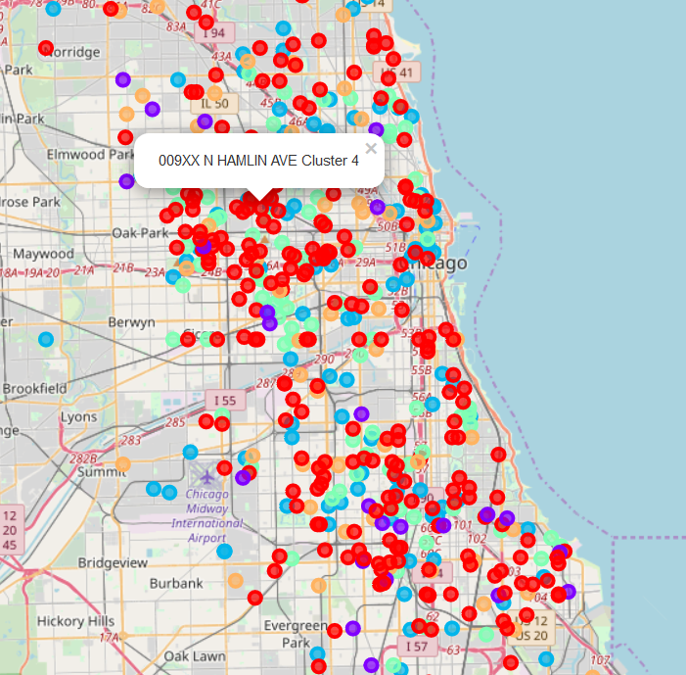
﻿Mapping the boroughs along with clusters on map

Slide 9
Conclusion
Through the exercise we will be able to identify which borough has which types of crime in common
and accordingly put them in clusters
As per the previous figure, Hamlin Ave falls in Cluster 4 in terms of crime types
The most common crime type in the borough is Narcotics
Hence the Chicago Police Department should deploy their Narcotics Bureau professionals in that area
and catch the culprits

Slide 10
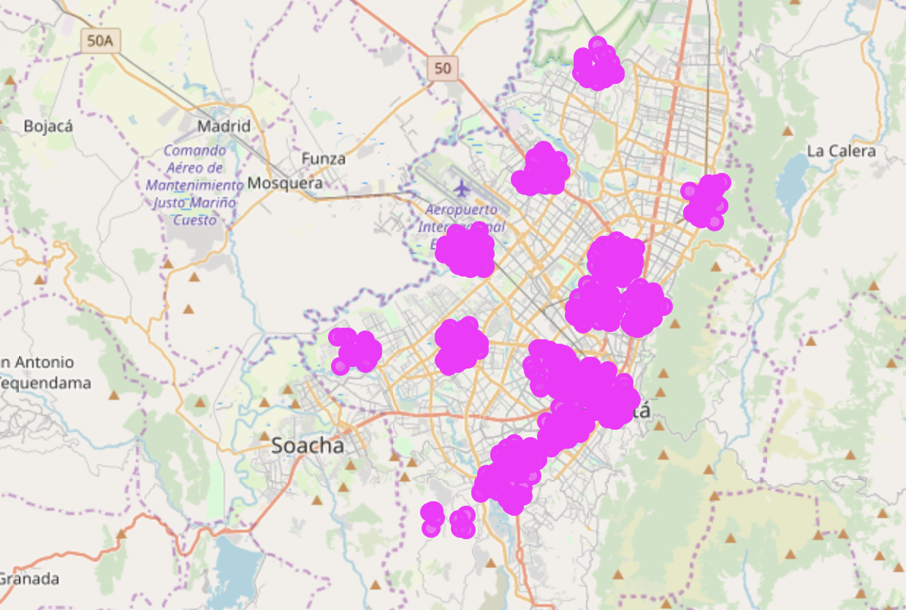
﻿Offices in Bogotá Localities

Slide 11
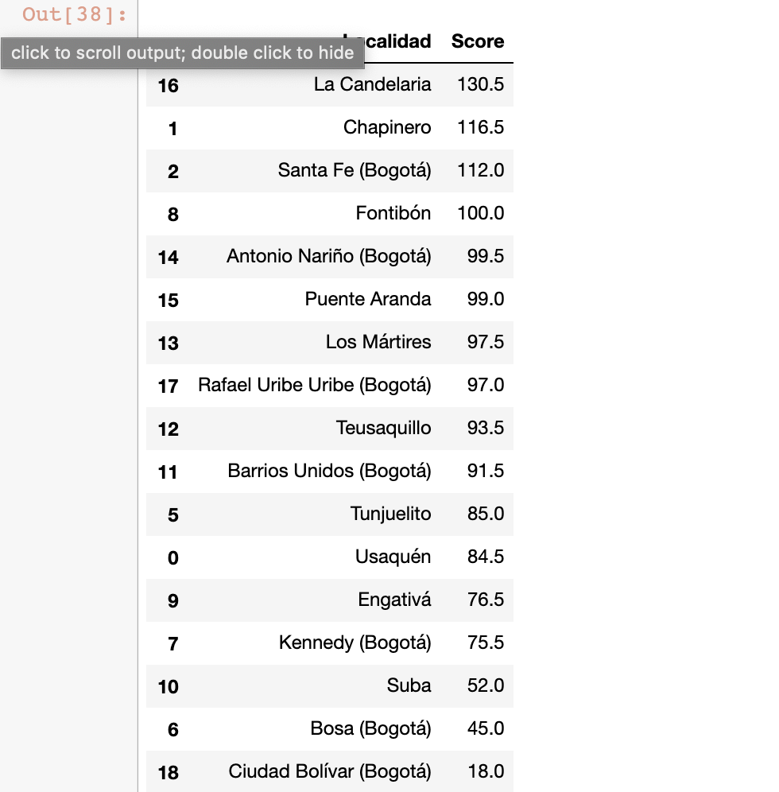
Results
﻿• The Locality with the bestscore is “La Candelaria” with 130.5, being the best option.
• Follows closely “Antonio Nariño” with 116.
• These options maximizes the number of potential customers from offices and universities and at the same time have not too large competence.

Slide 12
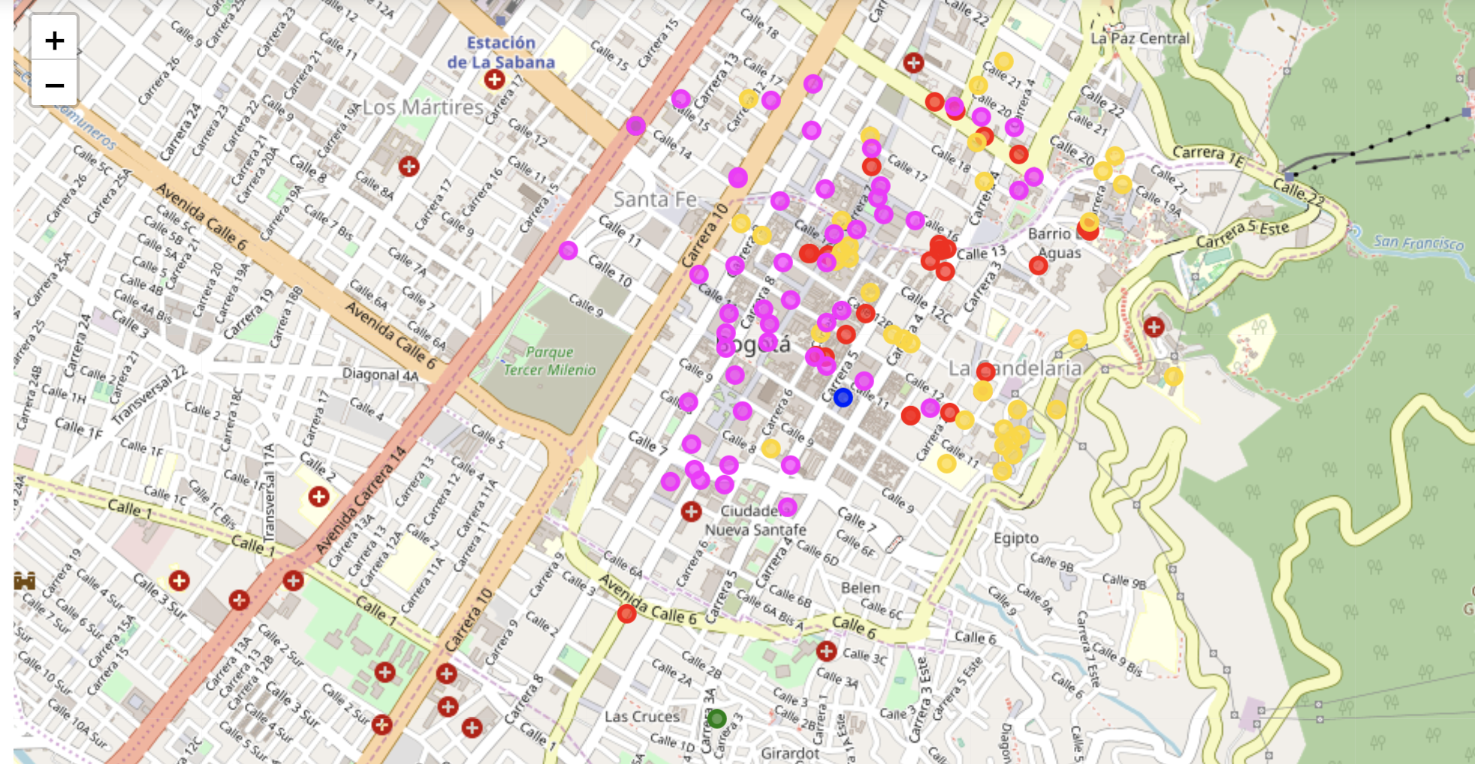
﻿Best Place for the Burger

Slide 13
﻿The following analysis can be improved with following extensions:
• Consider more categories. For example like "Night life” which is also a good source for customers. But also like "Restaurants", which even if not burger joints may by some concurrence if too many.
• In the Locality itself, it can also be computed the distance between all the venues in order to find a place with the
most number of potential customers.
• Using smaller geographical areas like Neighborhoodscould improve the accuracy for the scores.

